Slide 1
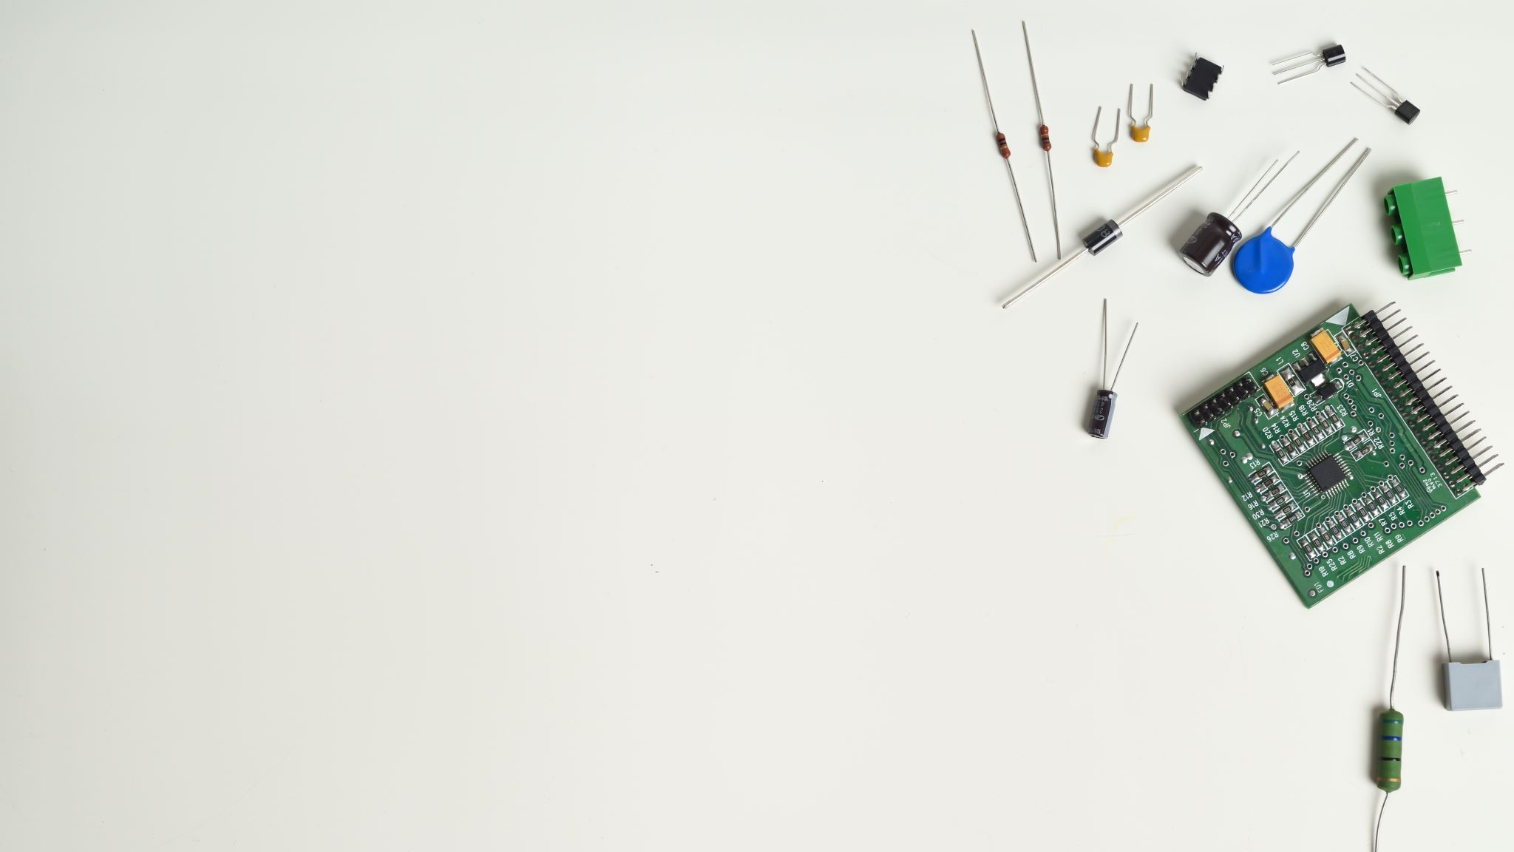
Azure IoT and MXChip
Wriju Ghosh
@wrijugh

Slide 2
https://aka.ms/iot-devkit

Slide 3
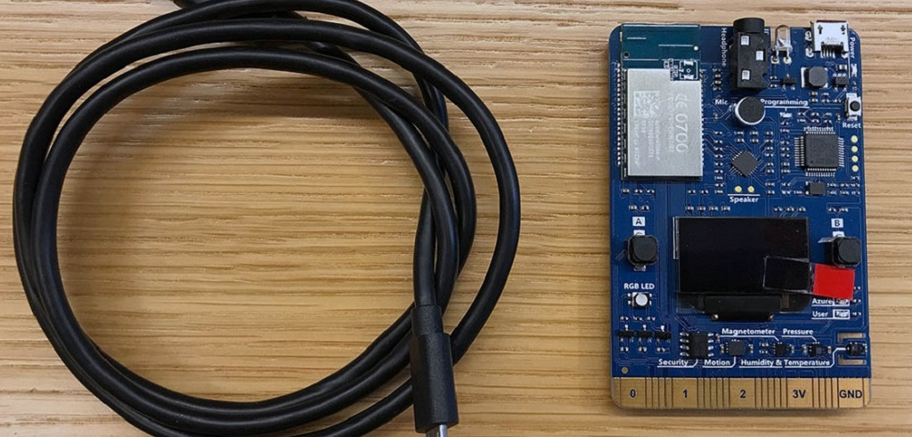

Slide 4
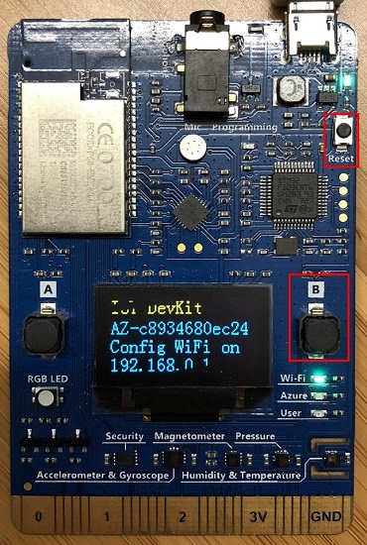
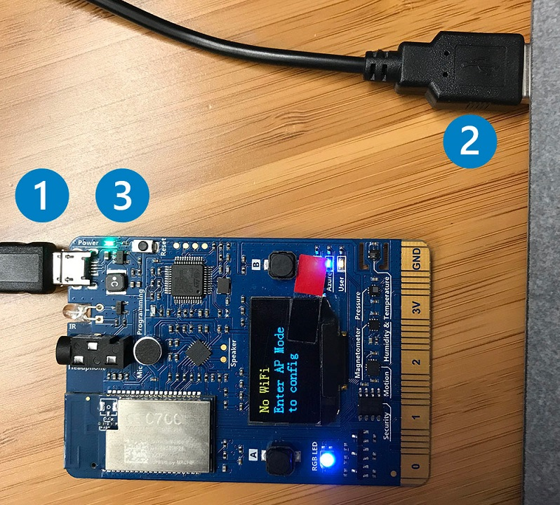

Slide 5
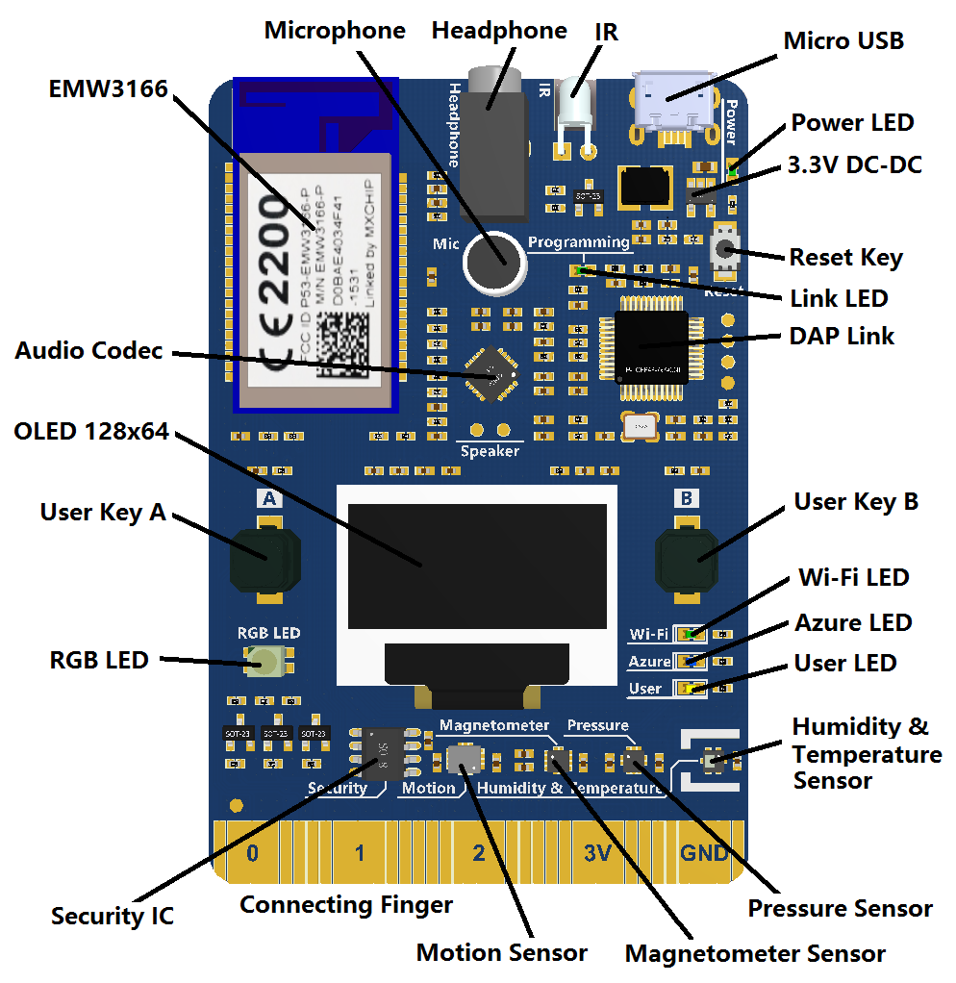

Slide 6
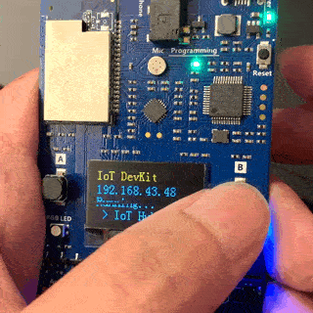

Slide 7
Azure IoT portfolio
Solutions
Azure IoT Central
Azure IoT Remote Monitoring
Azure IoT Predictive Maintenance
Azure IoT Device Simulation
Azure IoT Connected Factory
Services
Azure Digital Twins
Azure IoT Hub
Azure IoT Security
Edge
Azure IoT Edge
Azure Sphere
Windows IoT

Slide 8
IoT Edge
Azure IoT Edge
Azure IoT Edge
Things
IoT Hub
Insights
Actions
Insights
Actions

Slide 9
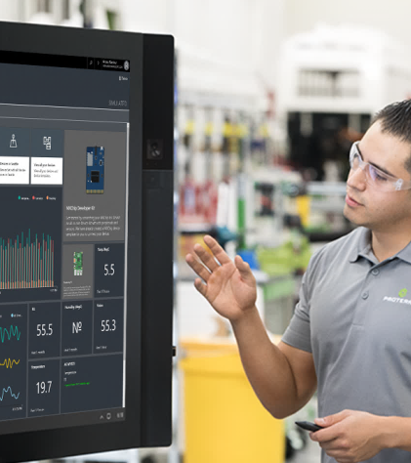
Fully hosted and managed by Microsoft
Generally available
No cloud development expertise required
Device connectivity and management
Azure IoT Central
Monitoring rules and triggered actions
User roles and permissions
Analytics, dashboards and visualization
Risk-free trial with simplified pricing
Try today:: http://azureiotcentral.com
Notes:
Reduces the complexity of IoT solutions with a fully managed SaaS offering for customers and partners that enables powerful IoT scenarios without requiring cloud solution expertise.
Simplifies the development process and makes it easy and fast for customers to get started, making digital transformation more accessible to everyone.
Available along with our existing platform-as-a-service (PaaS) solution, Azure IoT solution accelerators which enables deep customization and full control.
List from Ignite:
Fully managed SaaS solution
No cloud expertise required
Built in security best practices
New extensibility features
Transparent and predictable per device pricing
--------------------------------------------------------------------
Azure IoT Central is a market differentiating first SaaS offering for IoT by a hyperscale cloud provider designed to make IoT simple and accessible to large number of customers who want to take advantage of IoT without knowing anything about the cloud
Built on the Microsoft Cloud, Azure IoT Central is a Software-as-a-Service (SaaS) solution, designed to enable the rapid innovation, design, configuration and integration of smart products with enterprise-grade systems and applications to reduce product manufacturer’s go-to-market cycle and increase the speed at which they can innovate, so they can stay ahead of their competition and deliver smart products that delight their customers.
With IoT Central, we harness the key complexities of operating, managing, securing and scaling an IoT solution so customers can get results fast bring their connected product vision to life faster, without requiring cloud solution expertise.
Connect devices, set monitoring rules over your devices and get results fast by leveraging a fully-managed solution with built-in analytics for quick insights.
Azure IoT Central enables manufacturers to create a true digital representation of their products by modelling and connecting their products, collecting and analyzing data they send, and integrating with backend business processes.
Auto scaling
IoT Hub is a cutting edge IoT service to ingest massive amount of IoT data
If 1 device, certain scale. if a million, manual or code to scale
we handle this, we scale not only the Hub but all the underlying tech
Extensibility
In addition to the recently announced set of extensibility features, customers can now use Azure Functions to trigger serverless workflows that execute business logic without the need for setting up custom applications or infrastructure. The IoT Central connector for Microsoft Flow opens up hundreds of published connectors for no-code integrations to enable powerful scenarios like Connected Field Service (CFS) that help reduce costly scheduled maintenance by proactively detecting and resolving issues.
Additional features worth calling out <not included in slide bullets>
ARM template: create solutions larger than IoTC and deploy everything at once in marketplace or within your specific app
IoTC has Single-Sign-On so you use a single account to benefit from services across Azure and Office
Transparent and predictable pricing - price per device: makes it super easy to understand and plan cost of IoT solution
- Free trial: no need for Azure subscription

Slide 10

End-to-end implementation
Generally available
Completely customizable
Open-source microservices based architecture
Device connectivity and management
Azure IoT solution accelerators
Dashboards, visualization, and insights
Workflow automation and integration
Command and control
Preconfigured solutions
Remote monitoring
Connected factory
Predictive maintenance
Device simulation

Slide 11
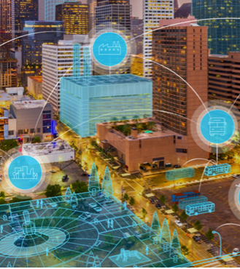
Public preview
Build next generation IoT solutions with Azure Digital Twins
Virtually represent the physical world with a digital twin that models the relationships between people, places and devices
Azure Digital Twins
Leverage predefined and extensible Twin Object Models to build contextually-aware solutions uniquely attuned to your industry domain
Buildings
Office
Retail
Hospitality
Cruise Ship
Automate actions in a space with custom functions that send events and/or notifications to endpoints based on incoming telemetry
Factory
Construction
Cities
Campus
Restaurants
Warehouse
Urban Mobility
Safety/Security
Stadium
Bank
Securely replicate solutions across multiple tenants through built-in multi and nested-tenancy
Airport
Parking
EV Charging
Renewables
Grid & Utilities
P

Slide 12
Digital Twins: Fusing physical and digital
Physical world
Data
Control
Data
Control
High scale, richer, more innovative business results
S
P
A
C
E
S
L
E
Context
Data
Control
O
P
P
E
System
Process
Intent,
context
Insight, optimization
D
E
V
I
C
E
S
Assistance, task completion
Insights
Measure
Digital world
Experience
Insight, optimization
Occupancy and utilization
Workplace advisor
Workplace analytics
Measure
Operations
Tenant apps
Employee productivity, comfort, satisfaction
Indoor mapping, location, wayfinding
Mixed reality
Cognition
Remote monitoring and fault detection
Predictive maintenance
Notes:
http://www.zdnet.com/emerging-tech-is-transforming-the-workplace-7000028960/
Our solution, Azure Digital Twins
Model not just devices—people, spaces

Slide 13
Azure Digital Twins for Smart Spaces
_{MODEL}
_{LIVE DATA}
_{BLOB STORAGE}
People, places, devices
Twin object models, properties and attributes
Topology and relationships
Devices and sensors
Building management and automation systems
BACnet, ModBus, KNX, LonTalk, Tridium, …
Documents (manuals, contracts, etc.)
Pictures
Maps (2D, 3D)
_{AZURE SPHERE}
_{MICROSOFT GRAPH}
PLAN - DESIGN - BUILD - OPERATE
_{AZURE IOT EDGE}
_{MICROSOFT AZURE}
_{OFFICE 365}
_{MICROSOFT 365}
_{AZURE IOT SERVICES}
_{ISV & SI PARTNER SOLUTIONS}
_{WORKPLACE ANALYTICS}
_{AZURE DATA &}
_{ANALYTICS SERVICES}
_{AZURE} _{DIGITAL TWINS}
_{MIXED REALITY}
AZURE VISUALIZATION AND INTEGRATION SERVICES
_{CORTANA}
_{AZURE ACTIVE}
_{DIRECTORY}
_{MICROSOFT TEAMS}
_{AZURE MAPS}
_{WINDOWS}
_{COLLABORATION DISPLAYS}
_{MICROSOFT}
_{DYNAMICS 365}
_{MICROSOFT}
_{SURFACE HUB}
_{OPERATIONS}
_{INSIGHTS}
_{EXPERIENCE}
Remote monitoring and fault detection
Predictive maintenance
Forecasting and optimization
Occupancy and utilization
Workplace advisor
Workplace analytics
Tenant apps
Employee productivity, comfort, satisfaction
Indoor mapping, location, wayfinding

Slide 14

Generally available
Establish bi-directional communication with billions of IoT devices
Enhance security with per device authentication
Azure IoT Hub
Provision devices at scale w/IoT Hub Device Provisioning Service
Manage devices at scale with device management
Multi-language and open source SDKs

Slide 15

Azure IoT Hub
Azure IoT Hub Device Provisioning Service
Bi-directional communication
Enterprise scale and integration
End-to-end security
IoT-scale automated provisioning
Millions of devices
Multi-language, open source SDKs
HTTPS/AMQPS/MQTTS
Send Telemetry
Receive commands
Device management
Device Twins
Queries and jobs
Billions of messages
Scale up and down
Declarative message routes
File Upload
WebSockets and Multiplexing
Azure Monitor
Azure Resource Health
Configuration management
Per device certificates
Per device enable/disable
TLS security
X.509 support
IP whitelisting/blacklisting
Shared access polices
Firmware/software updates
Azure security center support
Zero-touch provisioning
Centralize your provisioning workflow
Load balance across multiple IoT Hubs
Re-provisioning support
Supports TPM + X.509

Slide 16

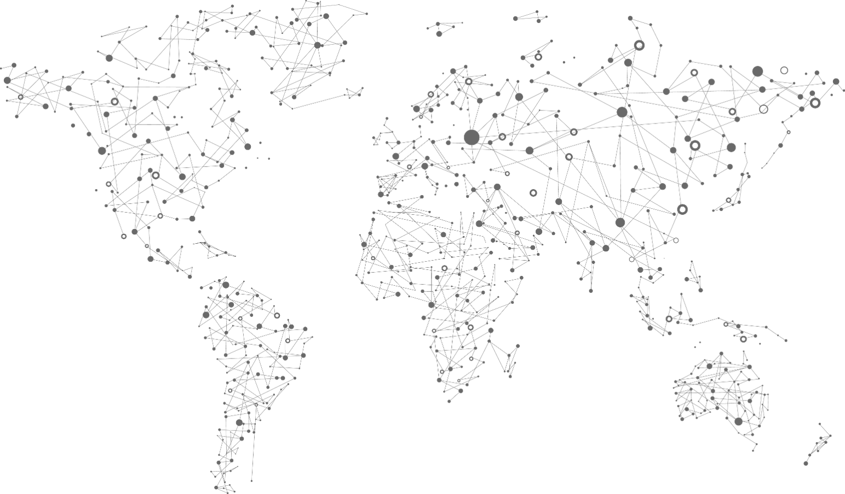
Azure IoT Hub Device Provisioning Service
Register and provision devices with zero-touch in a secure and scalable way
Simple "plug and play” provisioning
Minimize manual connection requirements
Enhanced security through HSM
Global availability
IoT Solution US
IoT Solution Germany
IoT Solution China
Notes:
Adding devices to an IoT solution has historically been manual and error prone
What IoT needs is “plug and play” device provisioning
Where the automation and repeatability controlled in a central location

Slide 17
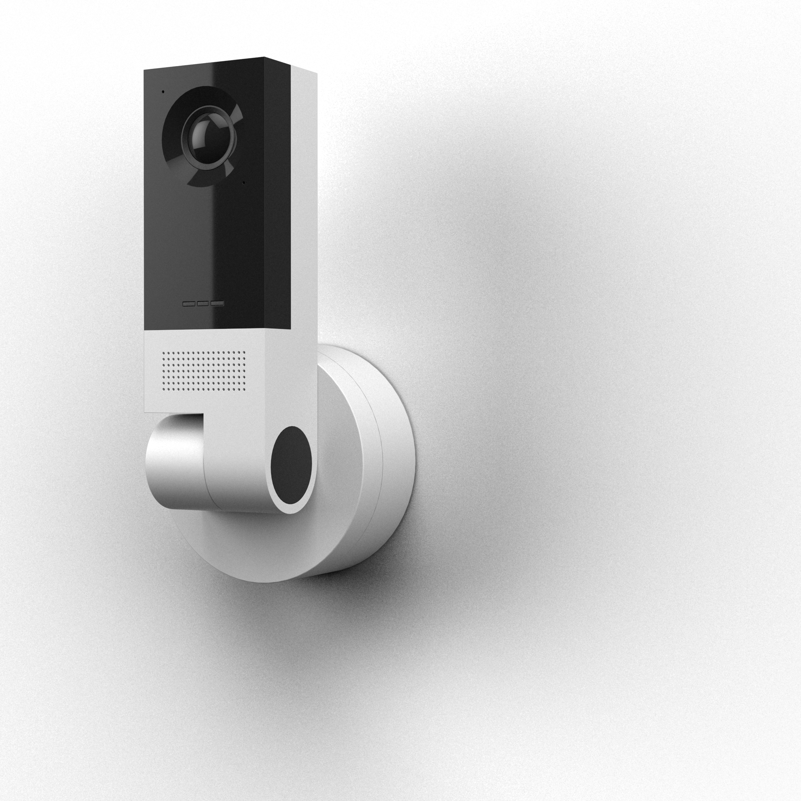

Shipping soon
Azure IoT Edge
Vision AI Developer Kit
Preregister now: https://visionaidevkit.com/

Slide 18
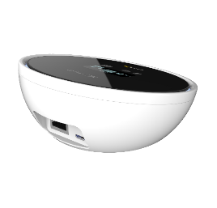
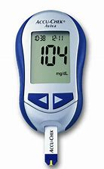
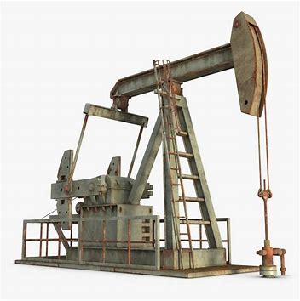
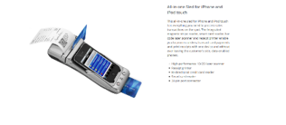
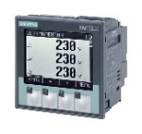
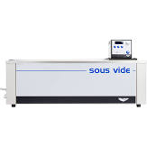
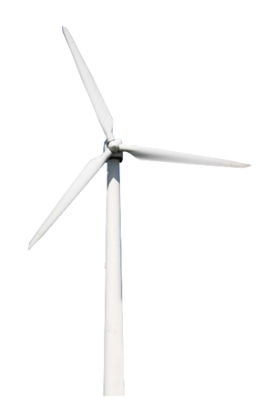
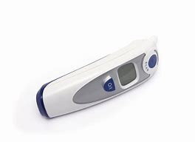
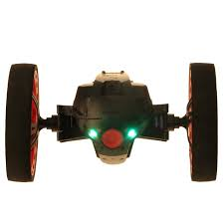
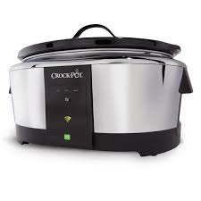
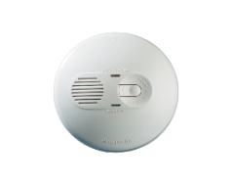
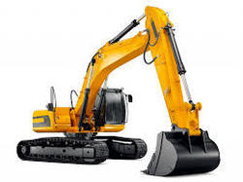

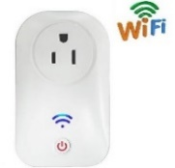
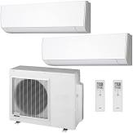
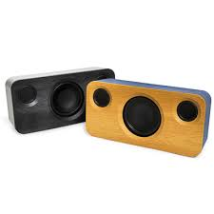
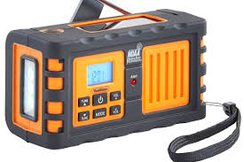
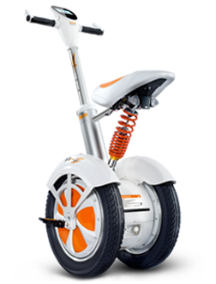
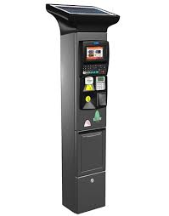


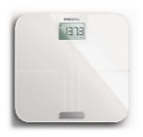
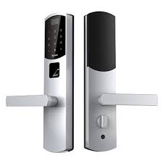
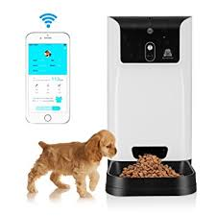
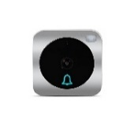
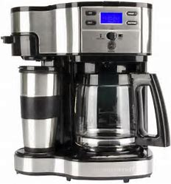
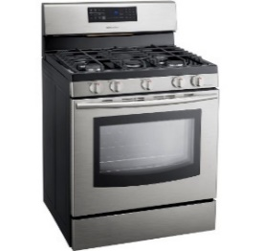
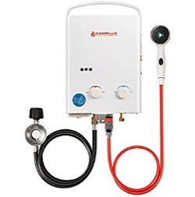
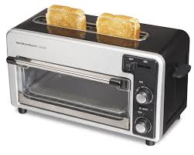
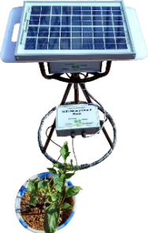
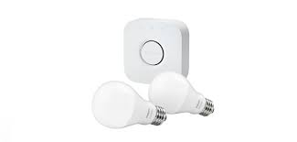
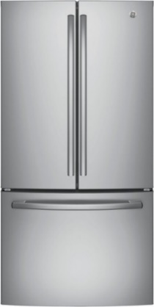
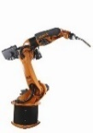
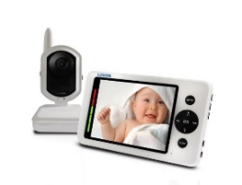
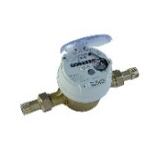
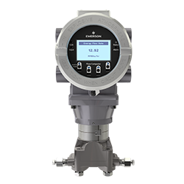

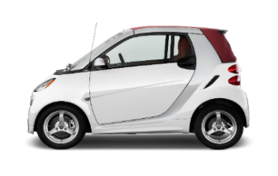
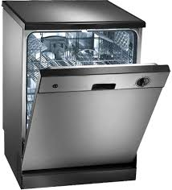
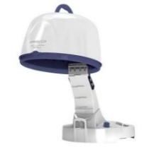
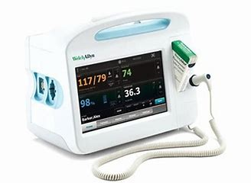
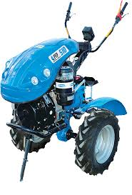
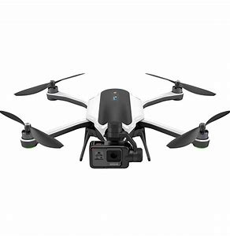
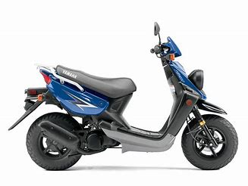







Public preview
A new Azure Sphere OS secured by Microsoft for the devices 10-year lifetime to create a trustworthy platform for new IoT experiences
A new Azure Sphere class of MCUs, from silicon partners, with built-in Microsoft security technology provide connectivity and a dependable hardware root of trust
Azure Sphere
The Azure Sphere Security Service guards every Azure Sphere device; it brokers trust for device-to-device and device-to-cloud communication, detects emerging threats, and renews device security

Slide 19

Get started with Azure Sphere today!
Now available
Azure Sphere development kits from Seeed studios
Public preview availability
Azure Sphere OS
Azure Sphere Security Service
Visual Studio tools for Azure Sphere
Try today:: http://www.azure-sphere.com

Slide 20

Generally available
Open platform that seamlessly connects things, endpoints, and the cloud
Commercial OS for IoT devices and a modern user experience
Supports the languages and frameworks you already know
Windows 10 IoT
Trusted platform for security and servicing of for cloud-connected devices
Bring power and capability to the edge
Enable a more nature user interface
Notes:
Azure Time Series Insights is a fully managed analytics, storage, and visualization service that makes it incredibly simple to explore and analyze billions of events simultaneously.
Time series data represents how an asset or process changes over time
Time series data has a timestamp and time most meaningful as an axis
Storing, indexing, querying, analyzing, and visualizing is challenging
IIoT exponentially generating more time series data

Slide 21



Windows 10 IoT + Azure Device-to-cloud platform for secure, manageable intelligent edge devices
Azure ML + Azure IoT Edge + Windows AI
Brings accelerated AI to your device
Windows 10 IoT
Secure, and manageable IoT OS with long-term support
Windows 10 IoT Device Management
Provided by Azure IoT Hub and enterprise device management
Windows Update + Device Update Center
Keeps devices secure, giving full control to the device maker
Notes:
When you take a step back, you can see what happens when you pull it all together.
Windows 10 IoT gives you the foundation of the secure OS with long-term support and loads of manageability options built in.
Windows Update with Device Update Center gives you security updates and puts you in full control of your devices.
Azure IoT Hub or enterprise device management will you get full device management right out of the box.
And the combination of Azure ML, Azure IoT Edge, and Windows AI makes it easy to bring accelerated, cloud-powered AI to your device.
[IoT Core supports enterprise device management / MDM. Intune enrollment works, but full Intune support not yet committed for RS5.]

Slide 22

Generally available
IoT scale time-series data store
Schema-less store, just send data
Azure Time Series Insights
Easy IoT Hub connection
Store, query, and visualize billions of events
Get near real-time insights in seconds
Build apps using Time Series Insights APIs
Notes:
Azure Time Series Insights is a fully managed analytics, storage, and visualization service that makes it incredibly simple to explore and analyze billions of events simultaneously.
Time series data represents how an asset or process changes over time
Time series data has a timestamp and time most meaningful as an axis
Storing, indexing, querying, analyzing, and visualizing is challenging
IIoT exponentially generating more time series data

Slide 23

Azure IoT solution accelerators integration
Azure IoT Central integration in progress
Generally available
Maps
Render maps and satellite imagery across many geographies
Map Control
Integrate rich mapping visualizations into applications
Azure Maps
Routing
Calculate routes from N to N points for optimal calculations
Search and Geocoding
Convert places and addresses to coordinates; or, convert coordinates to addresses or cross streets
Traffic
Show real time traffic information
Time Zones
Obtain time zone and current time information

Slide 24
Azure, Azure Stack, IoT Edge, and IoT
Available in Azure Regions
Full functionality
Azure
Azure IoT Central
Azure IoT solution accelerators
Azure
Azure Stack
Azure Services & Management on-prem
Managed by Azure or Locally
Azure Stack
Azure IoT Edge
Deploy and manage cloud services
Managed by Azure or Azure Stack
Windows IoT, Linux
IoT Edge
Windows IoT, Linux
Azure IoT Edge runs on Windows and Linux
Azure IoT Device SDK
Multi-device, multi-language, multi-OS
iOS, Android, Windows, Linux
IoT
Azure Sphere
Peerless security for MCU devices
Connect directly to Azure or via Azure IoT Edge
Azure SphereOS
IoT
Azure Sphere OS
Linux Kernel that modernizes MCU devices

Slide 25
Azure IoT reference architecture
Core Subsystems
UI & Reporting Tools
Visualize data and learnings
IoT Devices
Provision and send data from device to cloud
Cloud Gateway (IoT Hub)
Stream Processing
Business Integration
Stream processing and rules evaluation over data
Device Management
Storage
Store data
Integrate with business processes
Things
Insights
Actions
Notes:
Speaker notes:
At the core an IoT application consists of the following subsystems: 1) devices (and/or on premise edge gateways) that have the ability to securely register with the cloud, and connectivity options for sending and receiving data with the cloud, 2) a cloud gateway service, or hub, to securely accept that data and provide device management capabilities, 3) stream processors that consume that data, integrate with business processes, and place the data into storage, and 4) a user interface to visualize telemetry data and facilitate device management.

Slide 26
@wrijugh
Questions…
Notes:
https://github.com/Microsoft/vscode-iot-workbench/blob/master/docs/iot-devkit/devkit-shakeshake.md

